Slide 1
Memory Management
Part 3
Memory Management Strategies
Virtual Memory Management

Slide 2

Hardware Support
If the TLB is full, an entry should be selected for replacement
Replacement policies range from Least Recently Used (LRU) to random
Some TLBs allow entries to be wired down
These entries cannot be removed from the TLB
Major kernel code
Some TLBs store Address Space Identifiers (ASIDs) in each TLB entry
An ASID uniquely identifies each process and provides address-space protection for that process
Allows TLB to contain entries for several processes simultaneously
TLB must be flushed otherwise

Slide 3
Hardware Support
Hit ratio
Percentage of times that a particular page number is found in the TLB
Calculate the effective memory access-time with TLB hit ratio of 80%, 40% and 98%
Time to access memory = 10 nSec
Overall memory access time reduces with the increase in the hit ratio
Current generation processors have multiple levels of TLB
Core i7 CPU has two levels of TLB and separate TLBs for instruction and data at L1
L1: 128 entry I-TLB and 64 entry D-TLB
TLB is a hardware feature that is not visible to the user and the OS

Slide 4
Protection
Protection bits for each page frame is stored in the page table
All accesses to memory require access to page table with illegal accesses causing trap to the OS
Read-only, read-write, execute-only
Valid-invalid bit is used to indicate whether a page is in the address space of a particular process
Most processes use only a fraction of the total address space available to them
Most of the page table remains unused
Provide hardware support to avoid memory wastage
Page table length register (PTLR) is used to indicate the size of the page table

Slide 5
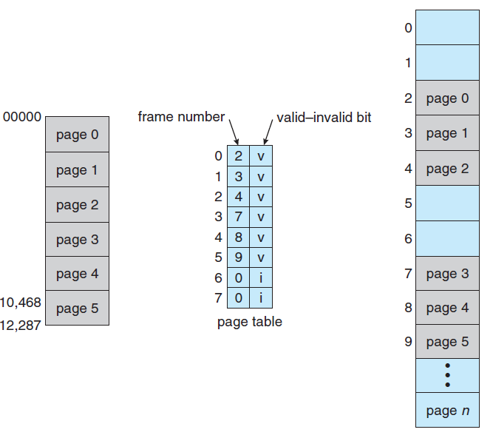
Valid (v) or Invalid (i) bit in a Page Table
Notes:
5
14-bit address space- can go upto 16383 address – if it uses only 10468 addresses with 2048 page size, allocated 6 pages that goes upto 12287

Slide 6
Shared Pages
An advantage of paging is the possibility of sharing common code
The reentrant code that are used by a large number of users can be placed in shared pages to save memory
Reentrant code
Non-self-modifying code that does not change during execution
Data will be unique for each of the processes that is running the code
Text editors, compilers, run-time libraries, database systems, etc. are the applications that can be used for sharing
The code needs to be read-only

Slide 7
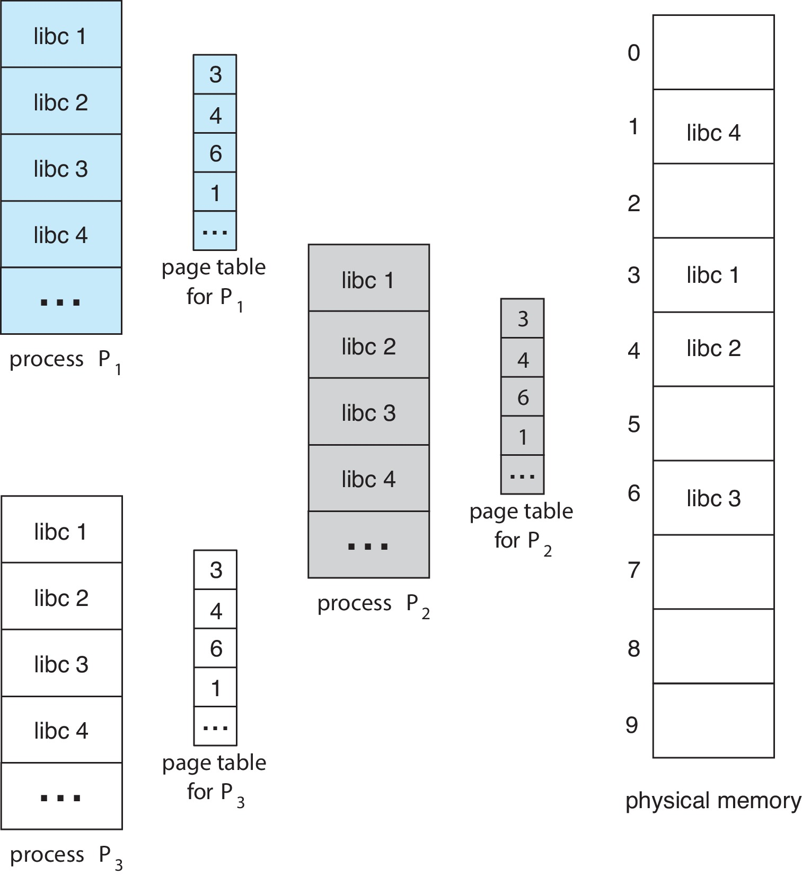
Shared Pages Example
Notes:
7

Slide 8
Structure of the Page Table
Hierarchical Paging
A large logical address space results in a large page table
Page table may need up to 4MB of physical address space for 32-bit logical address space
Solution
Divide the page table into smaller pieces
Several ways to divide page table into pages
Use a two-level paging algorithm
Page table is itself paged
Bits distribution for logical address would change
Address translation method would also change
Forward-mapped page table

Slide 9
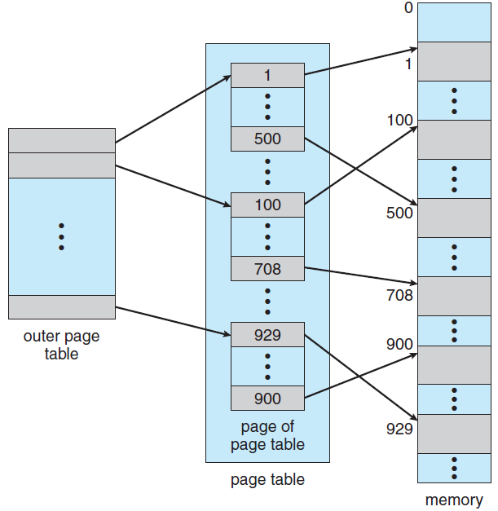

Two-Level Page-Table Scheme
10
10
12
Notes:
9

Slide 10
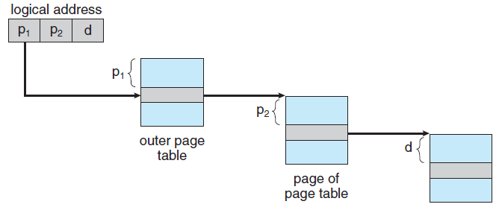
Address-Translation Scheme for a two-level 32-bit paging architecture
Notes:
10

Slide 11
Hierarchical Paging
For a large address space, two-level paging scheme is no longer appropriate
For example, a 64-bit logical-address space
Solution
Divide the outer page table into smaller pieces
The approach is used in 32-bit processors too
Outer page table can be divided in a number of ways
Three-level paging scheme
Next step is a four-level paging scheme
Problem
Multilevel paging scheme requires a large number of memory accesses to translate an address
Notes:
7-levels of paging in 64-bit Ultra-SPARC

Slide 12


Three-level Paging Scheme
Notes:
12

Slide 13
Hashed Page Tables
Use a hashed page table for handling address spaces larger than 32 bits
Hash value is the virtual page number
Each entry in the table contains a linked list of elements that hash to the same location
Each element consists of three fields
The virtual page number
The value of the mapped page frame
A pointer to the next element in the linked list
Working of the algorithm

Slide 14
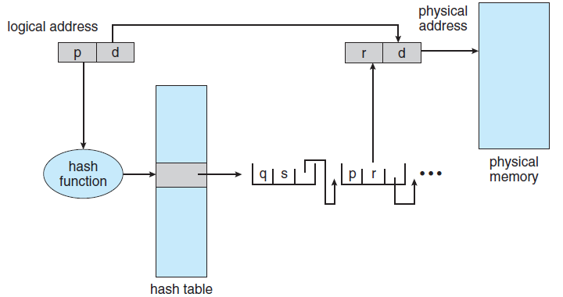
Hashed Page Table
Notes:
14

Slide 15
Hashed Page Tables
Clustered page tables
A variant of the 32-bit scheme mentioned before
Suitable for 64-bit address spaces
Difference from hash table
Each entry in the hash table refers to several pages in clustered page table
A single page-table entry can store the mappings for multiple physical-page frames
This is especially useful for sparse address spaces
Where memory reference is noncontiguous and is scattered throughout the address space

Slide 16
Inverted Page Tables
Each page table consists of millions of entries
Consume large amount of memory
Solution
Use inverted page table
It has one entry for each frame of memory
It contains the virtual page address and the id of the process that owns the page
Only one page table exists in the system
Working of the inverted page table
The scheme decreases the amount of memory consumed by the page table
Notes:
64-bit UltraSPARC and PowerPC use this method

Slide 17
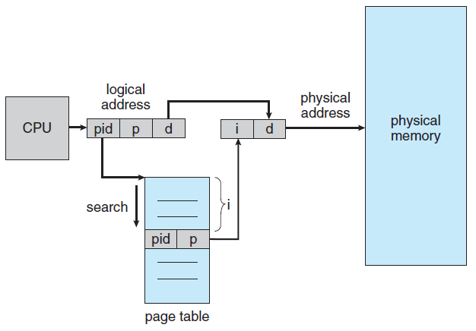
Inverted Page Table Architecture
Notes:
17

Slide 18
Inverted Page Tables
Problem
Increases the amount of time required to search the table
Entire table needs to be searched in worst case
Use hash table to alleviate the problem
At least two memory accesses are required to get a frame address
TLB is searched before any of the above operations
Systems using inverted page table have difficulty in implementing shared memory
Allow the page table to contain only one mapping of the virtual address to the shared physical address

Slide 19
Swapping
A process can be swapped out of the memory to a backing store temporarily
It can be later brought back into memory for continued execution
Possible for the total physical address space for all processes to exceed the physical memory of the system
Increase the degree of multiprogramming
Standard Swapping
Move entire process between main memory and backing store
Data structures associated with the process must also be swapped
Idle or mostly idle processes are good candidates

Slide 20
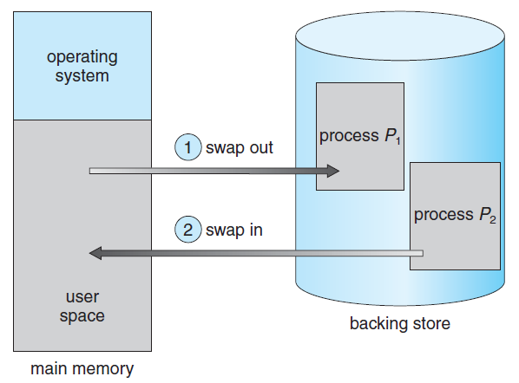
Swapping of Two Processes using a Disk as the Backing Store

Slide 21
Swapping
Swapping with Paging
Standard swapping is not used in contemporary systems
Amount of time required is very high
Swapping of pages of a process takes place
Term swapping is used for standard swapping
Paging refers to swapping with paging
Linux and Windows use this method
Page out: Moves a page from memory to the backing store
Page in is the reverse operation
Swapping works well with virtual memory

Slide 22
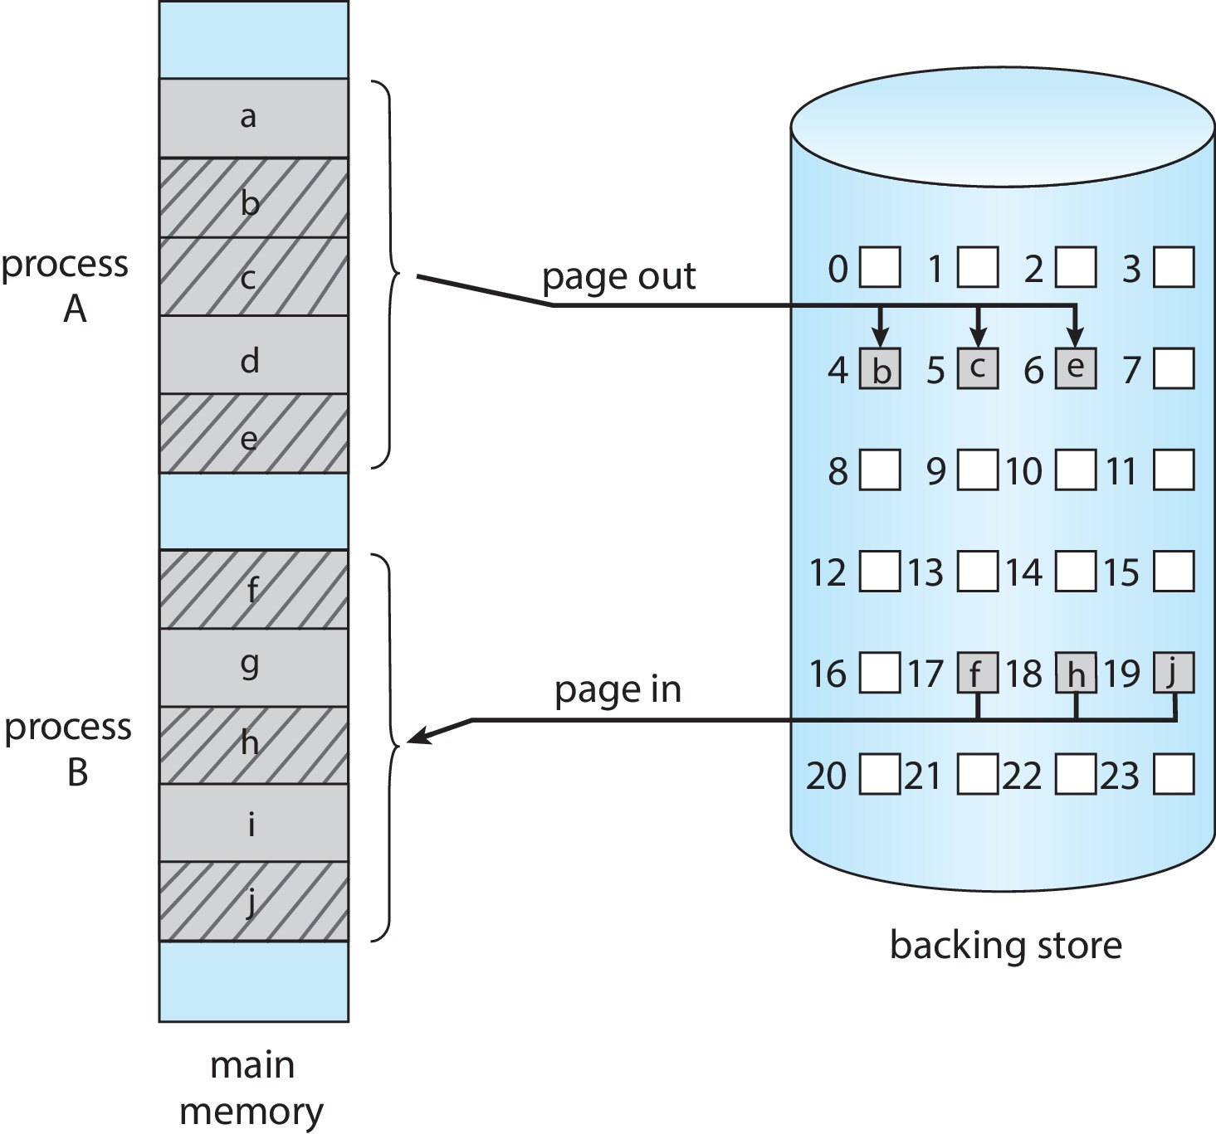
Swapping with Paging

Slide 23
Swapping on Mobile Systems
Mobile systems do not support swapping
Flash memory has limited storage
Flash memory can tolerate only limited number of writes
Poor throughput between main memory and flash memory
How to acquire memory space?
Apple iOS asks applications to relinquish voluntarily allocated memory
May also terminate a program
Android also uses similar strategy

Slide 24
Example: ARM Architecture
Most mobile devices use ARM processors
32-bit ARM processors support
4K and 16K page sizes
1MB and 16 MB pages termed as sections
1-level paging is used for 1MB and 16MB sections
2-level paging is used for 4KB and 16KB pages
Address translation in ARM MMU
ARM also supports two levels of TLBs
Outer level Micro TLBs
Data TLB and instruction TLB
Micro TLBs also support ASIDs
Inner level main TLB
Address translation starts at the micro TLB level
In case of miss, main TLB is accessed
Notes:
Most widely used architecture in terms of quantity of chips produced

Slide 25
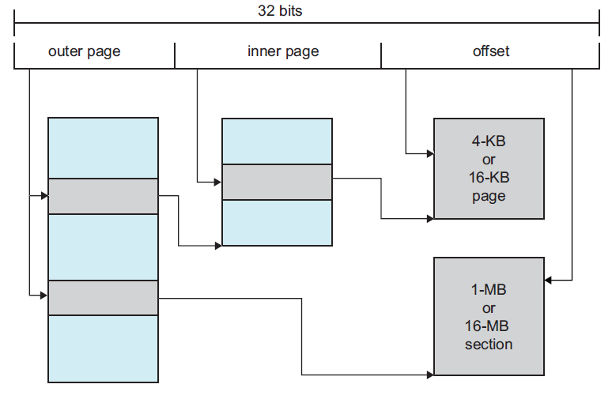
Logical Address Translation in ARM

